Slide 1
Provider Annual In-Service Training Presentation June 2023 For audio, click on the speaker icon at the bottom left of each presentation slide.

Slide 2
Training Purpose
To Review Current Handbook Requirements
Discuss Training Documentation by Setting
Discuss TRAIN Florida
Review Most Common Not Met Reasons
Provider Training Certificate Examples
Give Final Tips & Suggestions

Slide 3
Handbook Requirements

Slide 4
Annual In-Service Training - Handbook
Most current Handbook: May 2023 – Find it here:
https://ahca.myflorida.com/content/download/5933/file/59G-13.070_DD_iBudget_Waiver_Services_2023.pdf
Service Specific Training Requirements are in Appendix C in the handbook

Slide 5
Annual In-Service Training – Services
Behavior Assistant
Life Skills Development 1 (Companion)
Life Skills Development 2 (Supported Employment)
Life Skills Development 3 (Adult Day Training)
Life Skills Development 4 (Prevocational) NEW SERVICE
Personal Supports
Residential Habilitation – Standard
Residential Habilitation – Behavior Focus
Residential Habilitation – Intensive Behavior
Residential Habilitation - Enhanced Intensive Behavior
Support Coordination/CDC+ Consultant
Supported Living Coaching

Slide 6
Annual In-Service Training – Hours
4 hours of training required for the following services:
Life Skills Development 1 (Companion)
Personal Supports

Slide 7
Annual In-Service Training – Hours
8 hours of in-service training required for the following services:
Behavior Assistant
Life Skills Development 2 (Supported Employment)
Life Skills Development 3 (Adult Day Training)
Life Skills Development 4 (Prevocational)
Supported Living Coaching

Slide 8
Annual In-Service Training – Hours
8 hours of in-service training required for the following services:
Residential Habilitation – Standard
Residential Habilitation – Behavior Focus
Residential Habilitation – Intensive Behavior
Residential Habilitation - Enhanced Intensive Behavior

Slide 9
Annual In-Service Training – Hours
18 hours of in-service training required for the following services:
Support Coordination/CDC+ Consultant

Slide 10
Training Topics

Slide 11
Annual In-Service - training should related to:
Behavior Assistant
Applied Behavior Analysis and related topics
Life Skills Development 1 (Companion)
Personal Supports
Specific needs of at least one person currently receiving services

Slide 12
Annual In-Service - training should related to:
Life Skills Development 2 (Supported Employment)
Employment
Life Skills Development 3 (Adult Day Training) & Life Skills Development 4 (Prevocational)
Individually tailored services

Slide 13
Annual In-Service - training should related to:
Supported Living Coaching
Affordable housing options, asset development, money management, specific health needs of persons served, accessing governmental benefits other than those provided by the Waiver (such as food stamps or legal services), or employment-related topics

Slide 14
Annual In-Service - training should related to:
Residential Habilitation – Standard
Implementation of individually tailored services
Residential Habilitation – Behavior Focus, Intensive Behavior, and Enhanced Intensive Behavior
Applied Behavior Analysis and related topics

Slide 15
Annual In-Service - training should related to:
Support Coordination/CDC+ Consultant
Employment related services and benefits; school transition planning process; financial planning and government benefits; case management; person-centered planning; service options for Agency clients; affordable housing; characteristics of Agency clients; community and natural supports

Slide 16
Annual In-Service - training should related to:
Support Coordination/CDC+ Consultant (continued topics)
The abuse, neglect, and exploitation of Agency clients; behavioral and emotional health; crisis management; physical health and wellbeing; emergency preparedness, response, and recovery; characteristics and needs related to aging; technology components of Agency data management systems; and adaptive resources.
Refer to Chapter 65G-10.005 F.A.C. for more details

Slide 17
Training Documentation

Slide 18
Provider Completed Required Annual In-Service Training
Most Common Not Met Reasons:
Provider did not present documented evidence of completion of 8 hours of annual in-service training.
Provider did not present documented evidence of completion of 4 hours of annual in-service training.
Provider presented documented evidence of completing some but not all required 8 hours of annual in-service training.
The provider documentation demonstrated completion of some but not all 18 hours of job related annual in-service training.

Slide 19
Training Formats
In Person/ Face-to-Face
Webinar
Online/self-paced
Video/DVD

Slide 20
Where To Look For Training
Local Health Organizations
City/Municipalities
APD
Family Café
Empower Florida Conference
Online Learning Platforms

Slide 21
Where To Look For Training
TRAIN Florida Website
Accounts
Finding Courses

Slide 22
Where To Look For Training

Slide 23
TRAIN Florida
The APD Training Portal has instructions for obtaining an account.
Visit http://apdcares.org/providers/training/ for details.

Slide 24
TRAIN Florida
Once you have an account you will receive a student ID which will be linked to all your activities in the learning system.
As you complete courses they will be documented on your TRAIN Transcript.

Slide 25
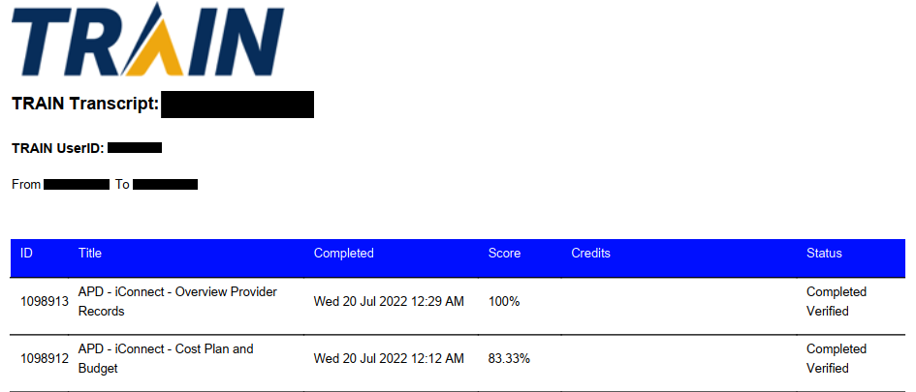
TRAIN Transcript With Name & User ID

Slide 26
TRAIN Florida
Courses
You can do a universal search of the website to find Courses, Training Plans or Resources.
You can also perform a detailed search within the Course Catalog

Slide 27
TRAIN Florida
The website has a variety of videos and job aids to assist you with getting the most from the learning system.
Click here to view tutorials and see job aids: https://www.train.org/tutorials/
Click here for Provider Advisories related to TRAIN Florida:
https://apd.myflorida.com/providers/advisories.htm

Slide 28
Annual In-Service Training - Certificates
Classroom - Certificate of completion must include:
Participant’s printed name and signature
Title of the course
Date the training occurred (day and date as well as beginning and ending time)
Printed name of the trainer and signature
Copy of the agenda or course syllabus

Slide 29
Annual In-Service Training - Certificates
Non-Classroom – Certificate of Completion must include:
Participant’s name
Title of the course (if not titled as in the handbook, then written confirmation of the course content may be required)
Date(s) or period over which training course was completed and notation that course was successfully completed
Length of training/Credit hours received
Name of entity providing training

Slide 30
Annual In-Service Training - Certificates
CD or Video – Certificate of Completion must include:
Photocopy of label or training outline (including the title of the course and sponsoring entity)
Printed name and signature of participant
Date training occurred
Length of training (if not noted on CD label)
Copy of the agenda or course syllabus

Slide 31
Examples & Tips

Slide 32
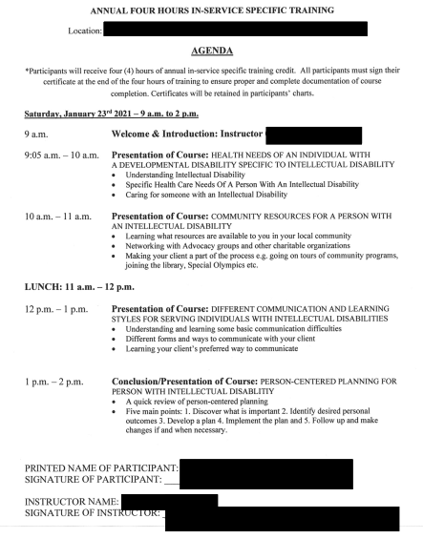
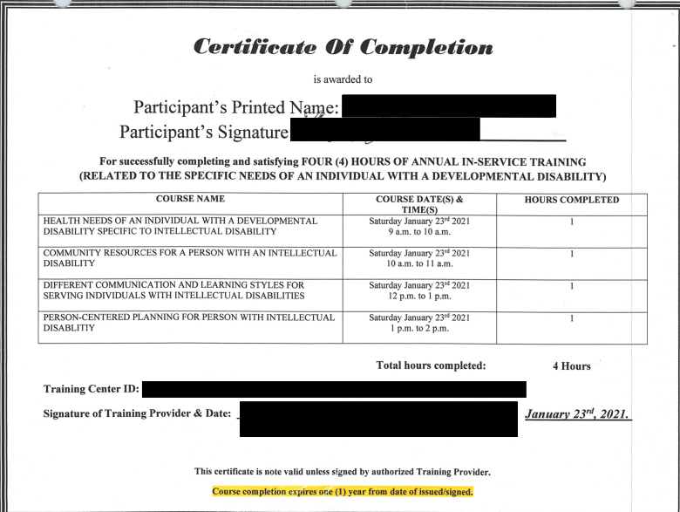
Classroom Certificate

Slide 33
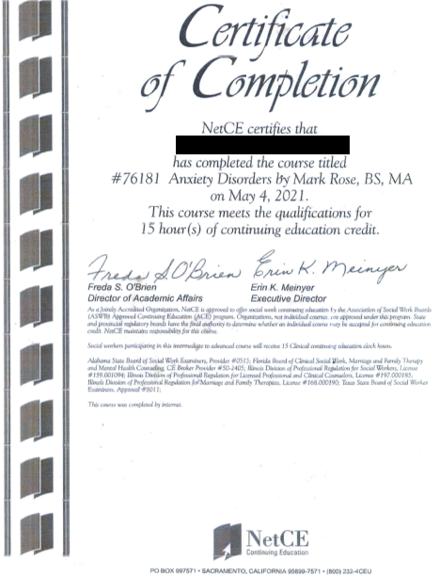
Non-Classroom Certificate

Slide 34
APD Webinar Training Certificate

Slide 35
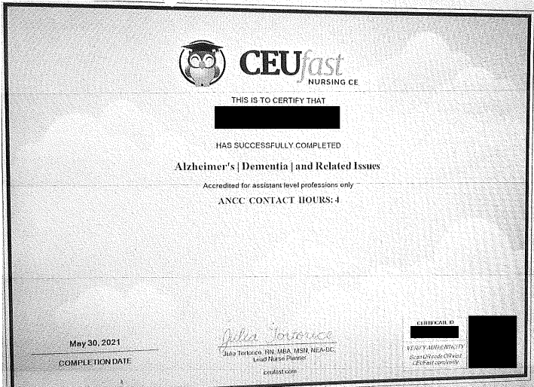
Non-Classroom Certificate

Slide 36
Classroom Certificate – Missing Trainer’s Name & Signature, Provider’s Signature and Agenda

Slide 37
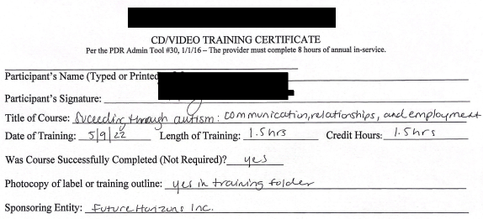
CD or Video Certificate – Missing Agenda

Slide 38
Annual In-Service Training – Staff Meetings
Staff person can attend a conference/training then come back and train others on relevant topics.
Examples of Activities That Do Not Count Toward Needed Hours:
Reviewing agency policies & procedures
Discussing Qlarant Tools and/or the Review Process
Reading an article or book

Slide 39
Annual In-Service Training – Staff Meetings
Make sure training topic within the session is relevant and matches service specific in-service requirements
Training Material – agendas, handouts
Trainers cannot issue themselves a certificate as the trainer

Slide 40
Annual In-Service Training – Final Tips & Suggestions
Review the Current Handbook, Appendix C for specific training areas based on the service you provide.
Talk with the person(s) being served (or someone who knows them best) and review their Support Plan to learn more about them.
Search the internet for live and online training.

Slide 41
Annual In-Service Training – Final Tips & Suggestions
Network with other providers to find out about training being offered in your area or courses they have taken.
Establish and document a date for how you track your 12-month training period and stick to it.
Have a system for tracking the number of hours you have completed during the year.

Slide 42
Annual In-Service Training – Final Tips & Suggestions
The 12-month period cannot be based on the annual Provider Discovery Review date each year.
Attending an APD meeting does not mean entire meeting can count for in-service hours.
Re-taking basic APD training courses will not be counted toward this requirement unless identified as a need in the APD Plan of Remediation.

Slide 43
Annual In-Service Training – Final Tips & Suggestions
View online training in its entirety.
Support Coordinators - In-Service Verification Form must be completed for non APD training - http://www.flrules.org/Gateway/reference.asp?No=Ref-12745
Review your documents to ensure compliance with the handbook requirements.

Slide 44
Florida Statewide Quality Assurance Program
Customer Service Representative:
Email: FSQAPcustomerservice@qlarant.com
Phone Number: 1 (866) 254-2075
Secure Fax Number: 1 (888) 877-5526
Where to find the tools:
https://florida.qlarant.com
Provider Review Tools>FSQAP Discovery Review Tools
Sign up for e-notifications

